Slide 1
Algorithms & Python
Deirdre O’Connor || deirdreoconnor1@gmail.com

Slide 2
Main topics of this course:
Writing + Running Python Code
Data Analysis + Data Management with Python
Code Optimization and Writing Efficient Programs
Coding Theory
Test-Driven Development

Slide 3
Skills acquired
To be able to write efficient and succinct, powerful programs using Python.
To analyze and create unit tests to ensure a high standard of coding.
To understand how to run Python code in a number of different environments.
To create medium-length programs to solve coding challenges.
To understand the process in designing programming solutions
To write efficient and optimised solutions to solve problems.

Slide 4
ASSESSMENT
Upon completing the class, there will be an assessment to create a mid-length program using many of the techniques and approaches that were covered in the lecture notes, such as including sufficient tests in the program.
The solution can be customized to your area of interest but must include a short paragraph explaining what real-life problem the solution addresses, why the particular approach was taken, and must include a flow diagram or equivalent to show the planning stage.

Slide 5
Coding theory

Slide 6
Chapter outline
Introduction to the course structure
Introduction to Python code
History of Python versioning
Why choose Python?
What can you do with Python?
Career prospects

Slide 7
Stop me at any point if you have questions

Slide 8
Python 2
Bookmark python.org for all documentation
First released in 2000, the most recent v2.7 was released in 2010.
Maintenance stops on 1st January 2020.
Replaced by Python v3.7.4
python.org even created a guideline for porting v2 projects to v3 as v2 will not be maintained after Jan 1st 2020.

Slide 10
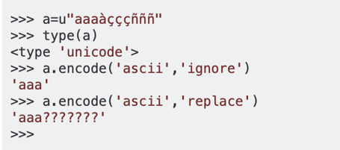
Python 2 vs python 3
Current version: v3.7.4
Strings
Strings in v2 use ASCII characters
Strings in v3 use Unicode - can store foreign language characters, numerals, symbols, emojis, etc.
• Print statements, raising exceptions
• Libraries
• Improved integer division.. this is a huge deal

Slide 11
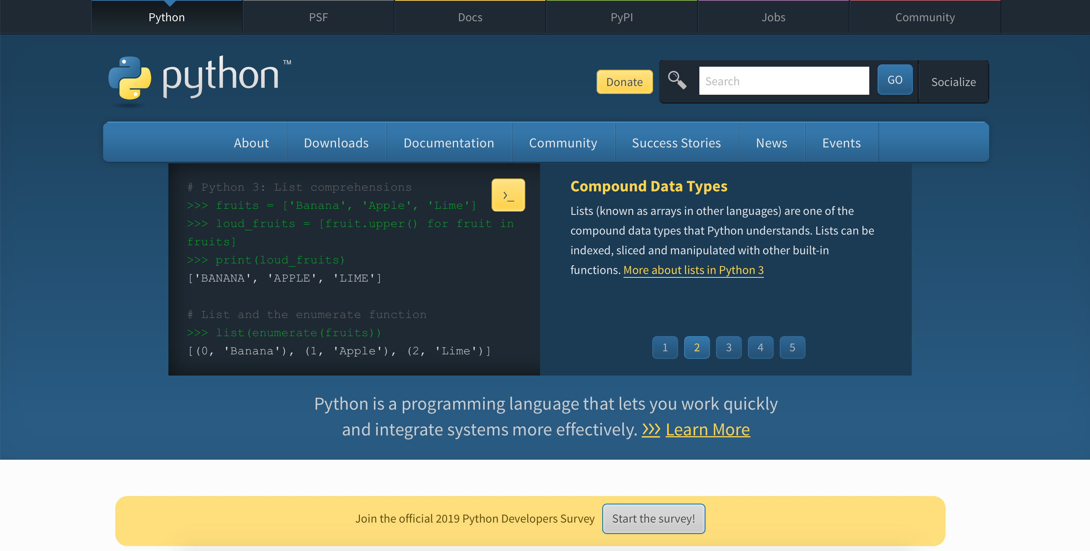

Slide 12
Why use python 3?
Cheatsheet: http://python-future.org/compatible_idioms.html
Dynamically assigning type - declaring and using a variable at once
In Python you can’t add an integer to a string, even though you never used a keyword to explicitly make the variable a string, Python understands based on what the variable holds.
Faster runtime. (Python 2.7 is not going to get faster)
Community support
Ease of using libraries means: no need to write or even maintain as much code
Easier to read and understand
Future-proof yourself - as more programmers switch to Python 3.

Slide 13
Python libraries
Bookmark python.org for all documentation
Graphing Libraries (Graph-tool)
Machine Learning Libraries (TensorFlow, SciKit Learn)
Data Analysis Libraries (NumPy)
Styling Libraries (PEP8)
Web-Development Libraries (WEB2PY)
Networking Libraries (NetworkX)

Slide 14
Why use python at all?
Bookmark python.org for all documentation
... is easy to learn, easy to use, and intuitive. ... is powerful and in widespread use. ... is a modern programming language (and e.g. knows about the internet). ... is a high-level language (like C, Java, ...).
... is interpreted (rather than compiled). ... supports object-oriented programming (but doesn't force it upon us)

Slide 15
Why use python at all?
Bookmark python.org for all documentation
Is Python 2 still used?
DevOps engineers/ those who work with configuration management tools might have to work with both Python 2 and 3
To work with a company’s legacy code written in Python 2
If you have a project that depends on certain third-party software or libraries that can't be ported to Python 3, you'll have no choice but to use Python 2 for it.

Slide 16
Plus, the average yearly salary for Python developers comes in at $92,000 per year, so if you learn Python 3, you might find your career prospects looking brighter than ever.

Slide 17
Code will be on GitHub
An online versioning tool and code repository
I highly recommend you use it
Link here to get started: https://github.com/DeeOConnor/Python_Algorithms_19
Choose a student account for free private repositories
Will be a place to show your portfolio of work to potential employers

Slide 18
Algorithms & Python
Deirdre O’Connor || deirdreoconnor1@gmail.com

Slide 19
Main topics of this course:
Writing + Running Python Code
Data Analysis + Data Management with Python
Code Optimization and Writing Efficient Programs
Coding Theory
Test-Driven Development

Slide 20
Running python code

Slide 21
Chapter outline
Introduction to Open Source
Running Python code
Variables
Print statements
Lists

Slide 22
Stop me at any point if you have questions

Slide 23
Python
Bookmark python.org for all documentation
Open Source:
something people can modify and share because its design is publicly accessible. It is also a way of life.
source code that anyone can inspect, modify, and enhance. It means you can share your knowledge and the programs you build, and that you are providing software for others.
Principles: open exchange, collaborative participation, rapid prototyping, transparency, meritocracy, and community-oriented development.
It looks fantastic on a CV.

Slide 24
Python: adding to the project
Bookmark python.org for all documentation
For your future career prospects, for additional learning and challenges, check out:
https://www.practicepython.org/ and https://inventwithpython.com/
Good first bugs:
https://github.com/catapult-project/catapult/labels/Good%20First%20Bug

Slide 25
Github
English/French cheatsheets: https://github.github.com/training-kit/
GitHub is a code hosting platform for version control and collaboration. It lets you and others work together on projects from anywhere.
You install git on the command line and can also access the Online repositories via github.com
Repositories are coding projects hosted online
We use branches to keep features of a project separate
We create commits to save changes of each user and then commit those changes to the master branch
Changes can then be reviewed, approved and merged
This allows us to track who makes what changes, and when.
This is called: version control and allows roll-backs when something goes wrong
Notes:
https://product.hubspot.com/blog/git-and-github-tutorial-for-beginners
https://git-scm.com/book/en/v2/Getting-Started-Installing-Git

Slide 26
Github: getting started (local)
Install git and create a GitHub account
Create a local git repository using git init
Create a branch
Add a new file to the local repo
Add to staging and review
Create a commit (include a message)
Check the log
Push the branch to Github
Notes:
Commits are saved changes
Pull request: When you open a pull request, you’re proposing your changes and requesting that someone review and pull in your contribution and merge them into their branch

Slide 27
Github: getting started (online repo)
Install git and create a GitHub account
Create a local git repository using git init
Create a branch
Add a new file to the local repo
Add to staging and review
Create a commit (include a message)
Check the log
Push the branch to Github
Create/Find an online repo
Git clone (makes a local copy)
Git branch, Add a new file
Add to staging and commit (include a message)
Git push
Create a pull request. Check online Repo
Review the changes in this Pull request
Merge to Master
Notes:
Commits are saved changes
Pull request: When you open a pull request, you’re proposing your changes and requesting that someone review and pull in your contribution and merge them into their branch

Slide 28
Github: interactive session
In your browser, go to:
https://github.com/DeeOConnor/Python_Algorithms_19

Slide 29
Writing & running python code

Slide 30
Method 1: using an IDE
An Integrated Development Environment can be useful for managing projects and files.
Can editing code, building executables, and debug issues all in the one application.
Gives a visual environment to help many inexperienced developers
Syntax highlighting means you spot issues much faster
PyCharm by Jetbrains: https://www.jetbrains.com/pycharm/
Visual Studio Code by Microsoft: https://code.visualstudio.com/download

Slide 31
Method 2: Using the command line
We run Python files using the following keyword python *.py
Can also use the interactive Python shell, like a less user-friendly interface of Jupyter
Run this to get started print(“Hello, world!”)

Slide 32
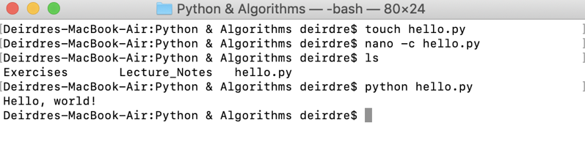
Method 2: Using the command line
$ touch hello.py -> to create the file called “hello.py”
$ nano -c hello.py -> edit the empty file with the nano editor. The -c command is to show the line numbers
$ ls -> list all of the files in the directory. Current directory is called “Python & Algorithms”
$ python hello.py -> run the file called “hello.py” as a Python file
Hello, world!

Slide 33
Method 3: Using an interactive ipython session
Comprehensive documentation: https://jupyter.readthedocs.io/en/latest/running.html#running
Jupyter - online I/O notebook to run python scripts
OpenSource and Free. Runs in web browser
Allows easy sharing of notebooks
Interactive output -> a blessing and a curse!
To install: pip install jupyterlab
To launch: In your preferred repository, type: jupyter notebook

Slide 34
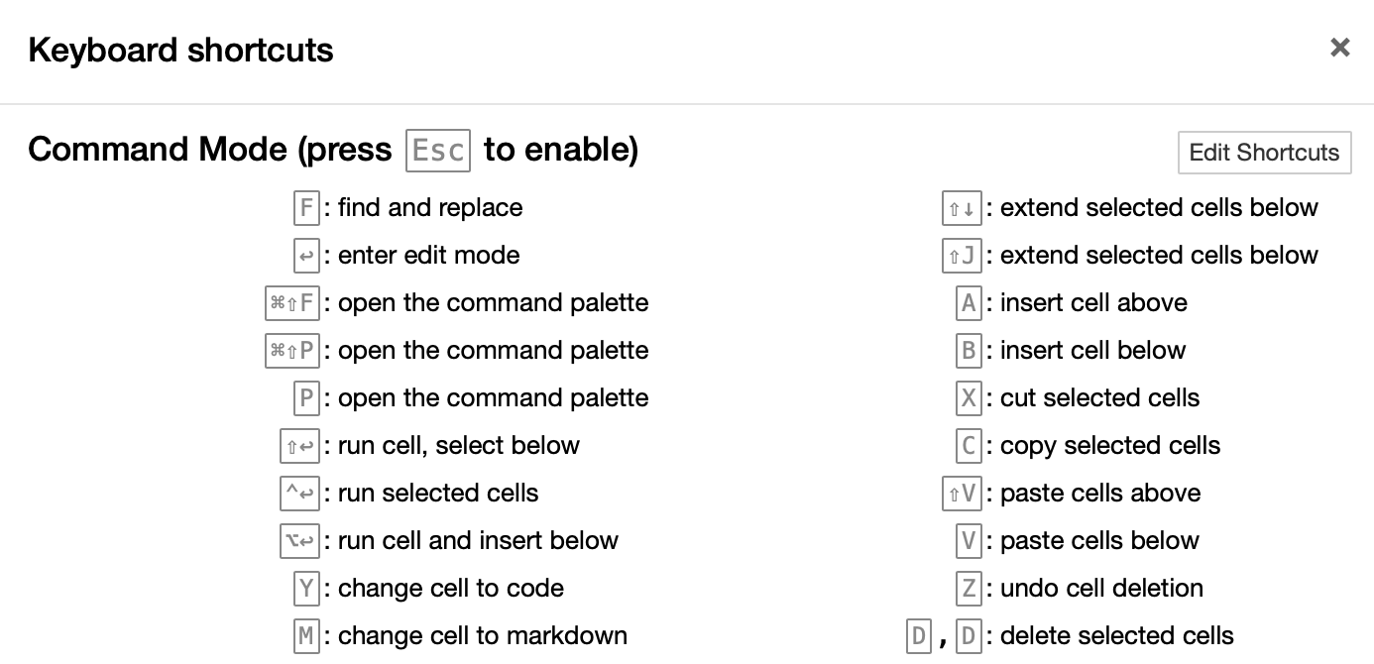
Features of Jupyter notebooks
Comprehensive documentation: https://jupyter.readthedocs.io/en/latest/running.html#running
Shortcuts Tab
Help > Keyboard Shortcuts

Slide 35
Features of Jupyter notebooks
Comprehensive documentation: https://jupyter.readthedocs.io/en/latest/running.html#running
Allows Markdown
Renders graphs directly in browser
Can be exported and downloaded
Can be run via Github with third party tools
Link to documentation
Type ?str.replace()
Allows for timing cell execution

Slide 36
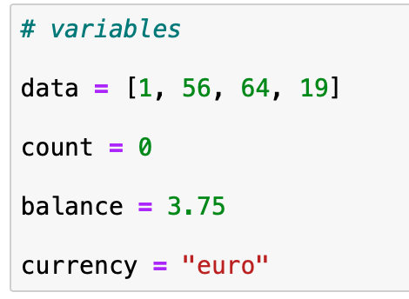
The basics: variables
Variables reserve a spot in memory. In Python they have no special prefix to declare variable type
These are all variables of different types. Python decides the type based on the data contained in the variable
Variables can be changed, and they become very useful in our code
The opposite of a variable is probably a constant: a value that will not be changed in your variable
Type type(var) to find the type of the variable
Sometimes we will need to change a variable’s type. This is called casting.
Read Section: Data Type Conversion
https://www.tutorialspoint.com/python3/python_variable_types.htm

Slide 37
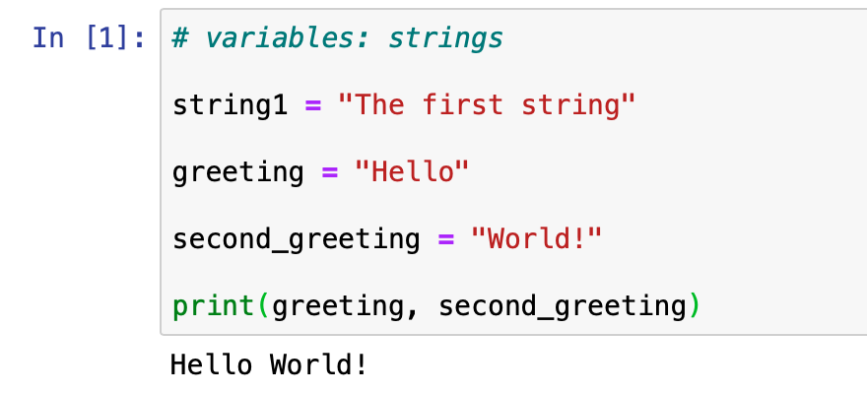
The basics:
Python has 5 standard data types
Numbers
String
List
Tuple
Dictionary

Slide 38
The basics: strings
Strings are made up of single letters or characters, wrapped in double quotes.
Python will accept single or double quotes. For simplicity’s sake, we will use double quotes.
Strings can be concatenated, meaning joined together and printed very easily.
Strings are immutable. This is very important!
An immutable object, such as a string cannot be altered or modified after it is created.
Instead, Python will make a copy of the object when a user tries to change it

Slide 39
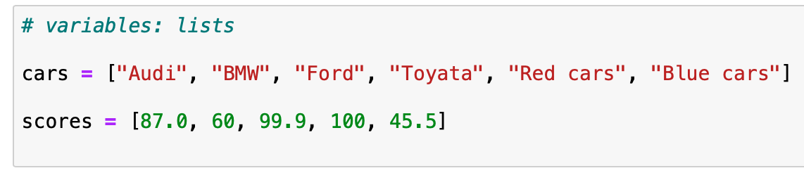
The basics: lists
Lists contain objects separated by commas and surrounded by square brackets.
They are constantly used in programming.
Lists can be very long, and generally contain 2+ items.
Items in a list can be numbers, strings, characters, and other lists.
Python lists are similar to arrays in other programming languages.

Slide 40
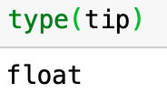
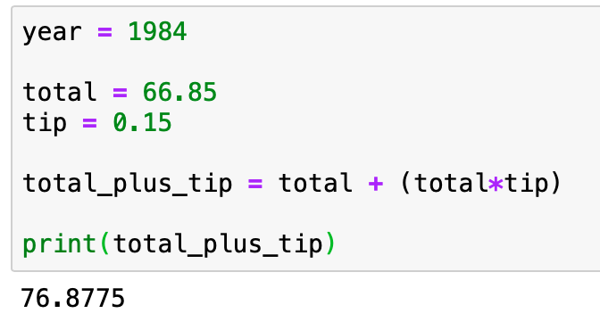
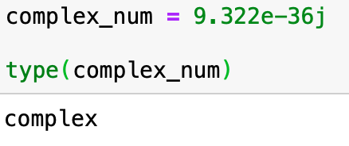
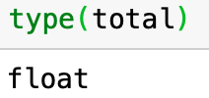
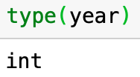
The basics: Numbers
Numbers can be:
Integers (whole numbers)
Floats (floating point numbers)
Complex numbers (show up a lot with Data Analysis and Big Data)
It is important to keep track of what number type we are working with. For example, the total of a meal in a restaurant probably won’t be a perfect integer

Slide 41
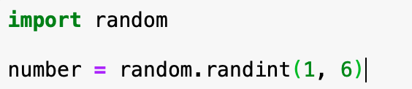
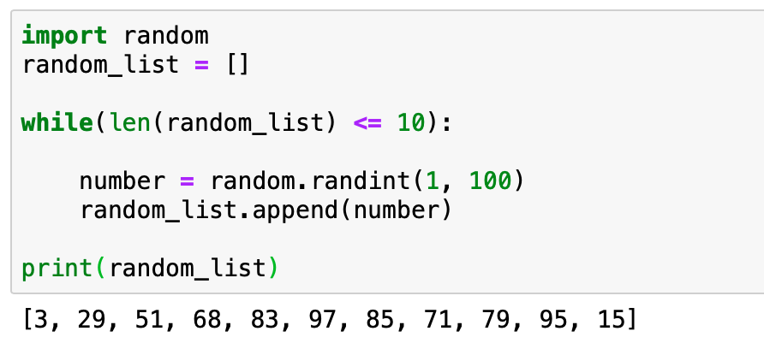
The basics: random numbers
We can create pseudo-random numbers in Python by importing the Random module

Slide 42
The basics: random numbers
Let’s run that a few times....
variable
module
function call
number = | random. | randint(1, 100)
arguments

Slide 43
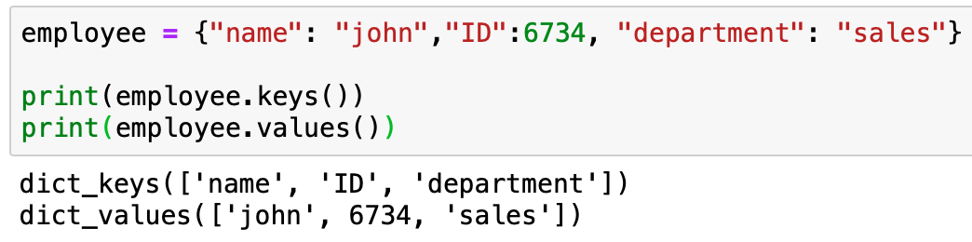
The basics: Dictionaries
Dictionaries are ordered data types
Made up of key, value pairs
They can be hashed, meaning retrieving data is very easy
Keys can be numbers or Strings
Values can be any Python data type

Slide 44
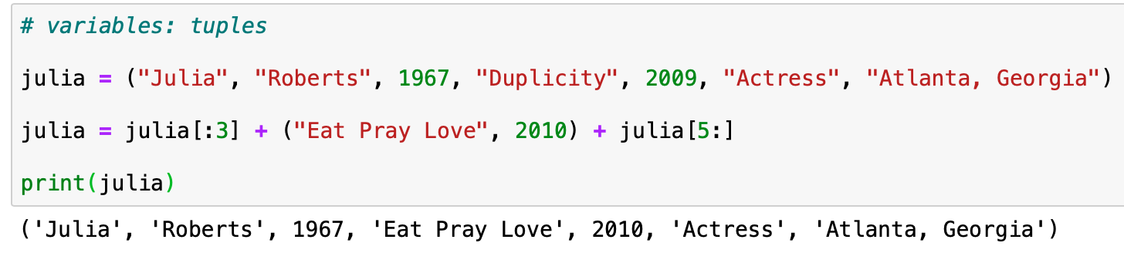
The basics: tuples
Tuples are similar to lists as they consist of a number of values separated by commas.
Lists are mutable meaning they can be overwritten. Tuples are immutable, like strings.
Unlike lists, however, tuples are enclosed within parenthesis.
The values of tuples cannot be changed or updated.
Think of them as READ-ONLY lists, or information records.

Slide 45
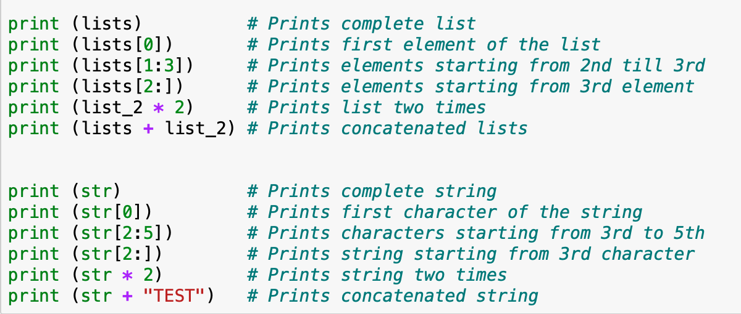
Strings as lists
Strings can be thought of as a list of characters, where characters grouped together make a word, and words grouped together make a sentence.
This means we can use the same operations with a string and a list

Slide 46
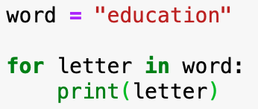
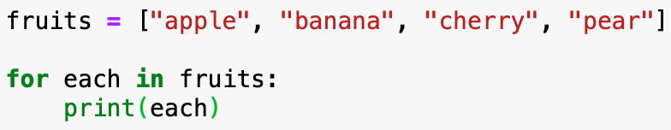
For loops
Iterates over a sequence / naturally iterable items
That can mean a list, a tuple, a dictionary, a set, or a string.... anything with order.
Doesn’t work with booleans
Use a for loop to execute a statement once for each item in a sequence
Continue statement: stop on the current iteration of the loop, continue with the rest
Break statement: break out of the loop / continue with the rest of the program

Slide 47
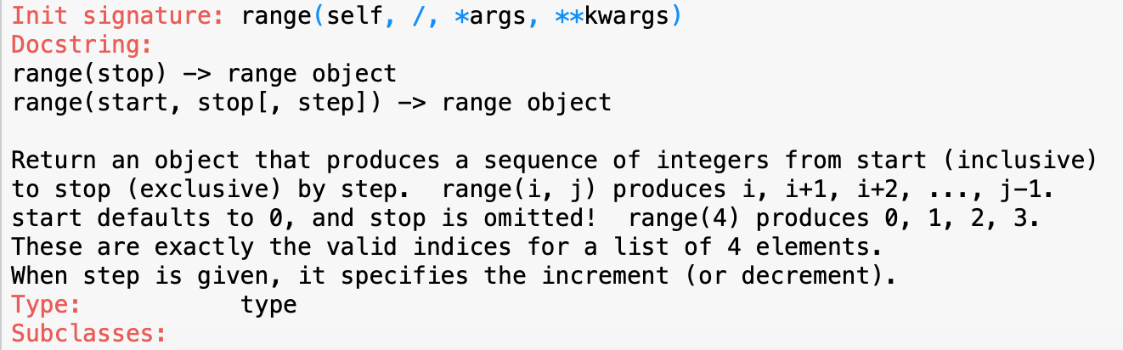
For loops: ranges
If you want a loop to execute a number of times, can use the range function
>>> ?range
Set (starter, stop, step)
Or simply set starter and stop
Beware: Out of bounds exception

Slide 48
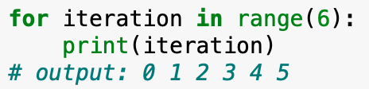
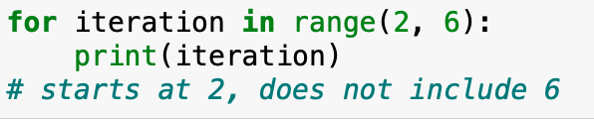
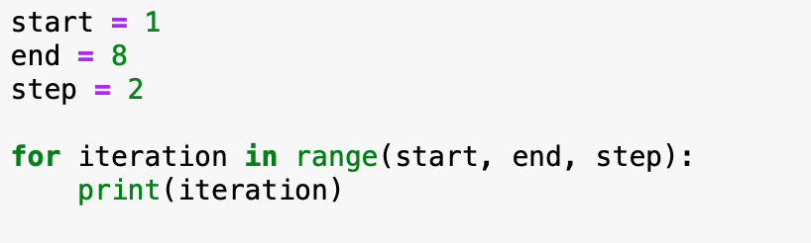
For loops: ranges
If you want a loop to execute a number of times, can use the range function
What will the output be?

Slide 49
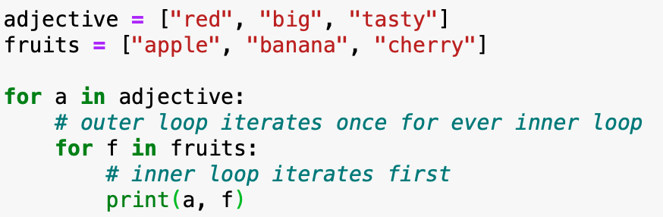
Nested For loops
How many times will these loops iterate? (How many print statements will there be?)

Slide 50
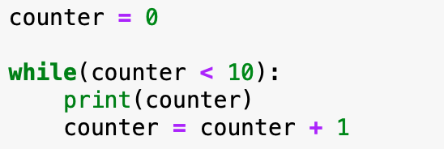
While loops
Execute as long as a statement is True.
Work with Booleans: variables that can be True or False only. Do not iterate over a string.
While loops can work with conditions. The loop will run while a condition is met.
Challenge: create a While loop that will print out all numbers from 0 to 10.

Slide 51
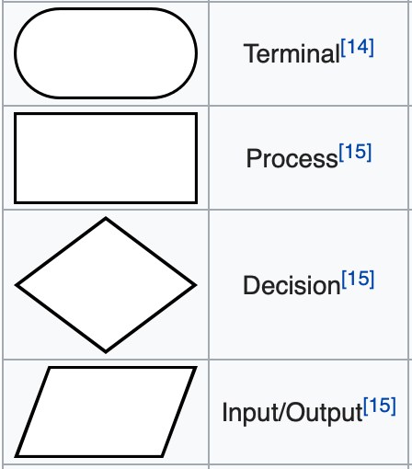
python loops
Challenge: Draw a flowchart to represent a While loop
Challenge: Draw a flowchart to represent a For loop

Slide 52
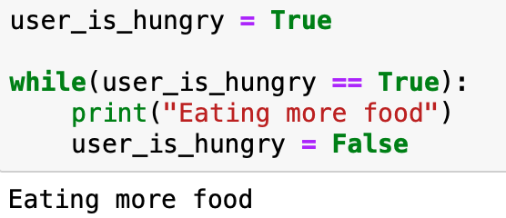
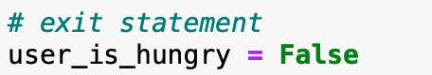
While loops
Challenge: eat more food while user_is_hungry = True
For now, it prints once but we might need to use this approach in more complicated examples.
The exit statement stops the loop from continuing forever.
Infinite loops are bad and can crash your computer and programs!

Slide 53
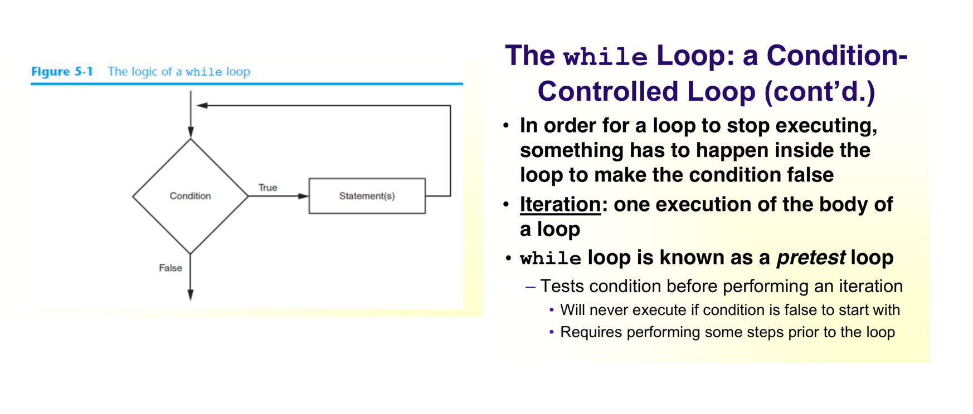
While loops

Slide 54
Break / pass / continue
Break: break out of this loop, continue with the rest of the program
Pass: don’t do anything in this loop
Continue: don’t do anything in this iteration, continue the loop on the next iteration

Slide 55
Infinite loops
Infinite loops will not give you an exception to read because the loop never terminates
How to identify the signs?
Fan, CPU, unresponsiveness
Loops must contain within themselves a way to terminate
Something inside a while loop must eventually make the condition false
Infinite loop: loop that does not have a way of stopping
Repeats until program is interrupted
Occurs when programmer forgets to include stopping code in the loop

Slide 56
Conditional statements
Computers read Python code generally in procedural way: top to bottom; left to right.
Conditional statements give the instruction to execute the following codeblock if a certain condition is met.
Conditional statements use the following syntax:
if(condition): do this else: do that
Can be used on their own and in for/while loops.
Also use break, pass, continue, return, and print statements

Slide 57
Conditional statements
Challenge: fix the infinite loop
Challenge: don’t print “s”
Challenge: don’t print unless it’s “x”

Slide 58

comments
Sometimes we need to write instructions for other coders, not to be read by the computer
Comments can be TO-DOs
Issues
Reminders
Special instructions
Warnings
Outputs

Slide 59
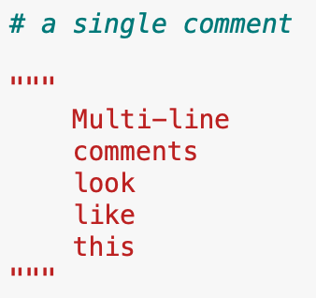
Comments
Single line comments start with this symbol: #
Multi-line comments are wrapped in """three straight quotes""" like so.
A computer cannot read code inside a comment so make sure you are careful when using them.
Can be helpful when debugging, as you try to find one line of code that is causing problems.

Slide 60
Styling conventions
Code style matters. Messy code leads to bugs!
Introducing: Pep8
How to decipher feedback
The big debate: Spaces vs tabs
Variable names: lower_case and underlines
Always include a __main__ in programs
Notes:
https://docs.python-guide.org/writing/style/
https://realpython.com/python-pep8/

Slide 61
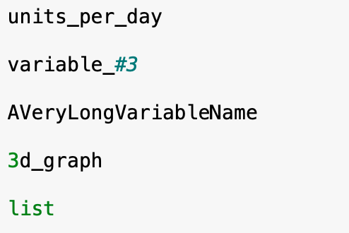
styling conventions
Rules for naming variables in Python:
Variable name cannot be a Python key word. Variable name cannot contain spaces
First character must be a letter or an underscore. After first character may use letters, digits, or underscores
Variable names are case-sensitive and name should reflect its use

Slide 62
garbage collection
When a variable is declared but not used, it will be disposed of to keep code and memory clean.
Python is a dynamically typed language, meaning variables can be assigned at run-time.
A problem can occur when reassigning a variable at runtime then breaks earlier parts of your code - this can happen often when using Jupiter notebooks and whenever you restart the kernel.

Slide 63
Time for a break..!

Slide 64
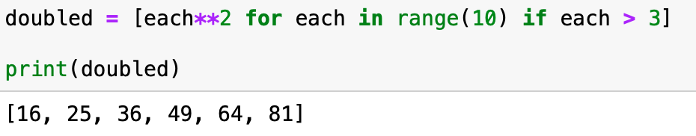
List comprehensions
In Python we can make lists in one line with conditional statements and simple operations.
It’s complicated but if you can practice it’s very powerful.
First, give the new list a name
Then, define what its items will be
Include for loops, ranges, or another list if wanted.
Conditional statements and calculations can operate directly on the items

Slide 65
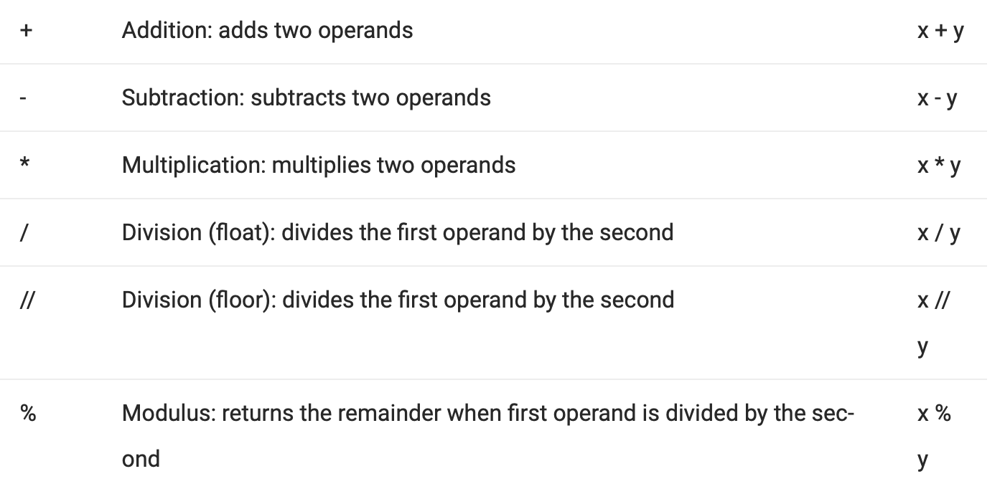
operators
Name: Operation: Example

Slide 66
Additional operations
str1 + str2:
concatenates strings, making a copy of each and joining them together.
str[:3] + ” and " + str[4:]:
joins the string “ and ” to the middle of string between slices.
input()
used for taking input from a user, defaults to type string.

Slide 67
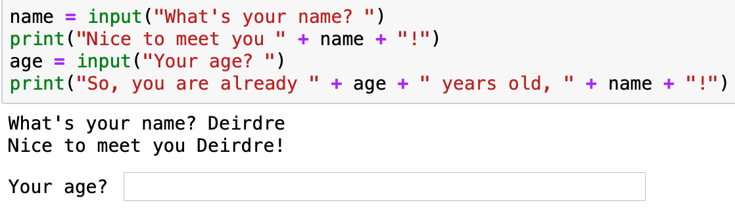
Casting types
At its default, age will be of type: string.
We need to cast the variable age to an integer when we take input.

Slide 68
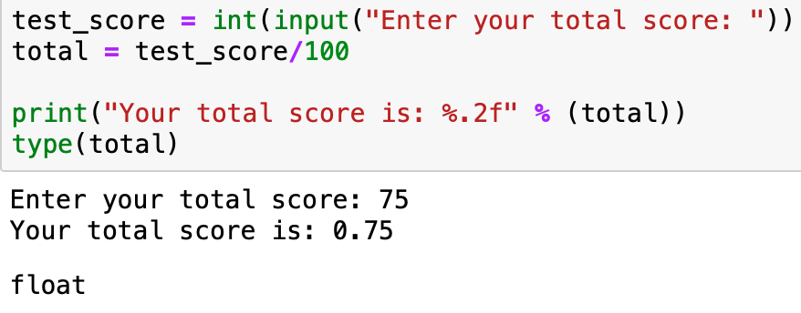
Casting types
test_score begins as an integer but after division becomes a float automatically
We print it as a float to two decimal places inline using the % operator in the string
We can write an instruction with the input() command or leave it blank.
Notes:
https://www.learnpython.org/en/String_Formatting

Slide 69
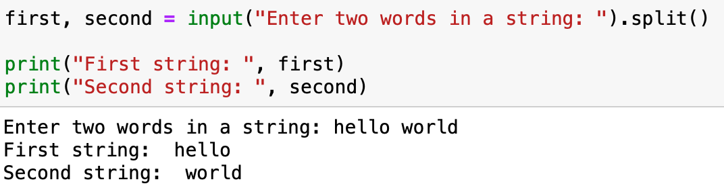
Taking input
When taking input, we explicitly state the input type (unless it’s a string)
Can also split the input on a particular character
on a comma if reading a list of inputs
on a space if extracting words from a sentence
Split if a non-alphanumeric character is part of the input using if statements

Slide 70
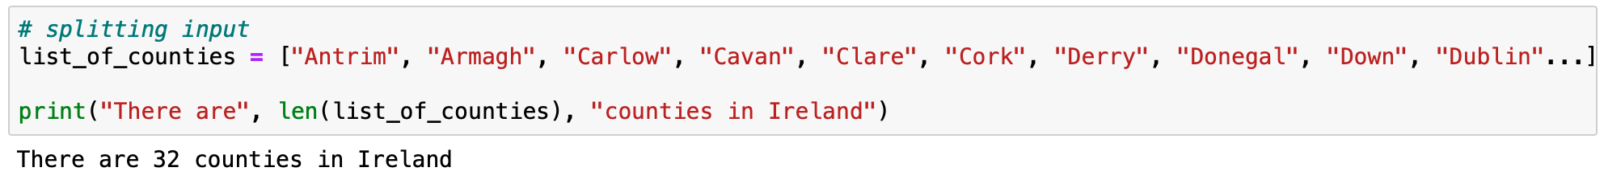
Challenge: extract the County names
Given a list of all counties in Ireland with spaces between them as input,
Read and split them and create a list instead
Then print the length of the list
Then print all counties that begin with the letter “W”.
Notes:
http://www.waterfordwebdesign.ie/alphabetical-list-32-counties-ireland/
CSV: Antrim, Armagh, Carlow, Cavan, Clare, Cork, Derry, Donegal, Down, Dublin, Fermanagh, Galway, Kerry, Kildare, Kilkenny, Laois, Leitrim, Limerick, Longford, Louth, Mayo, Meath, Monaghan, Offaly, Roscommon, Sligo, Tipperary, Tyrone, Waterford, Westmeath, Wexford, Wicklow

Slide 71
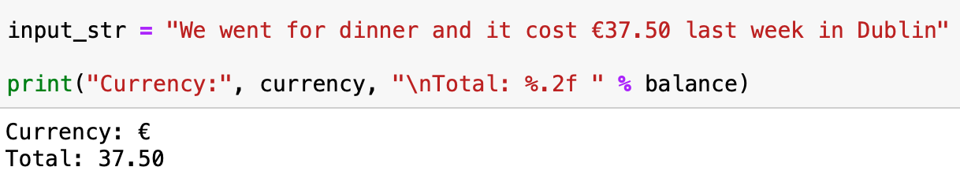
Challenge: extract the Number
Given a sentence with numbers and non-alphaneumeric values as input,
Read and split the string to find the float value for variable balance
Extract the symbol representing currency in variable currency
BONUS: Extract the city name, if in list_of_counties then print("We visited", county)

Slide 72
Googling errors

Slide 73
Error messages
Python error messages are very google-able (not a word!)
Stack Overflow is a good website to bookmark
Try to include all relevant information when looking up an error
Python’s documentation has a lot of helpful advice and examples of what could be going wrong
When a program encounters an error it stops
As we learn what types of errors might occur, we can learn how to handle them while the program executes so that things can exit gracefully. This is called exception handling
Notes:
https://www.tutorialsteacher.com/python/error-types-in-python
Defn: immutable
Don’t ever forget this
Syntax Errors

Slide 74
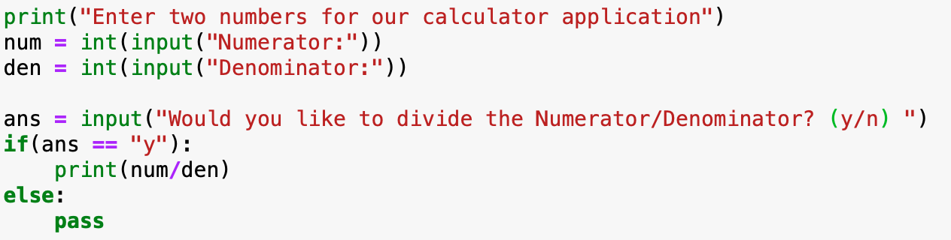
Exception handling
When you think that you have a code which can produce an error then you can use exception handling.
The best example is a simple calculator application where users give input of two numbers (x, y) and can do calculations such as division: x/y
If y = 0, this division is impossible, and your program needs to handle the exception so that the computer does not crash.

Slide 75
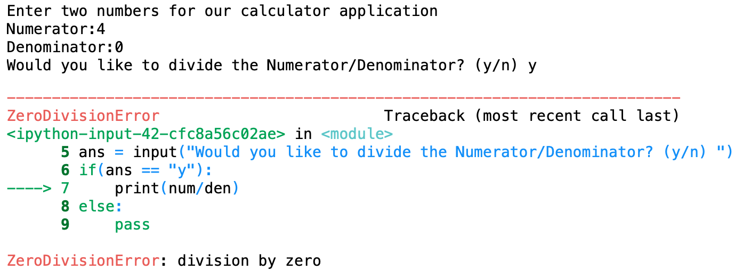
Exception handling
If y = 0, this division is impossible, and your program needs to handle the exception so that the computer does not crash.

Slide 76
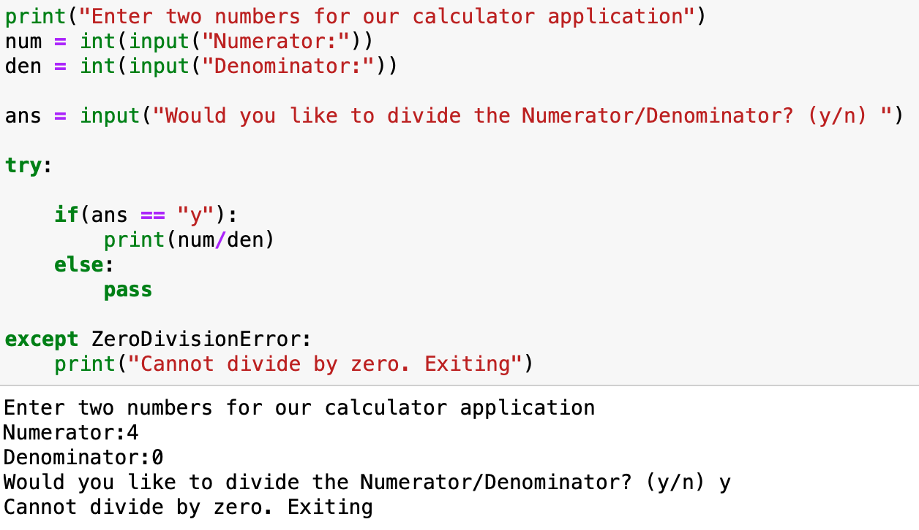
Exception handling: Try / catch blocks
If y = 0, this division is impossible, and your program needs to handle the exception so that the computer does not crash.
Notes:
https://www.tutorialsteacher.com/python/error-types-in-python

Slide 77
Common exceptions
https://docs.python.org/3/library/exceptions.html
IOError If the file cannot be opened.
IndexError Iterator object is out of range
ValueError Raised when a built-in operation or function receives an argument that has the right type but an inappropriate value
KeyboardInterrupt Raised when the user hits the interrupt key (normally Control-C or Delete)
SyntaxError If you have made a mistake in the use of a statement for example
EOFError Raised when one of the built-in functions (input() or raw_input()) hits an end-of-file condition (EOF) without reading any data
Notes:
https://www.tutorialsteacher.com/python/error-types-in-python <– these are good!
Defn: immutable
Don’t ever forget this
Syntax Errors

Slide 78
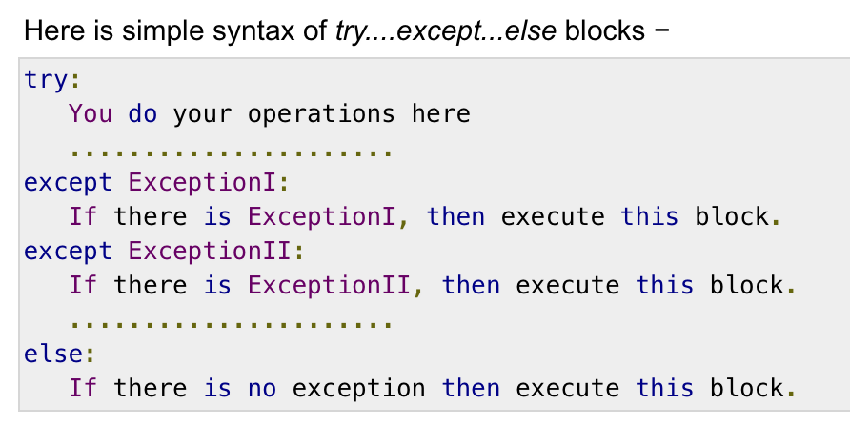
Python exceptions
https://www.tutorialspoint.com/python3/python_exceptions.htm
Understanding exceptions, where they come from or what they relate to will help you when debugging your programs and ultimately to become better and more aware coders.
Always try to prepare your code for exceptions

Slide 79
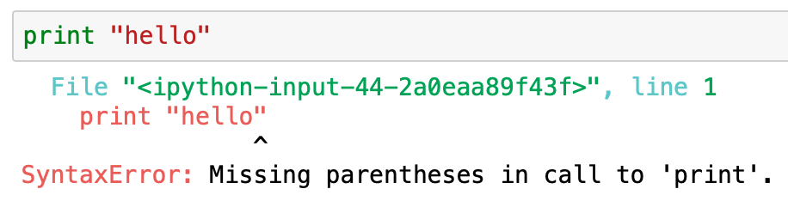
Common errors with string / lists
Splicing strings
Reversing
Accessing indexes

Slide 80
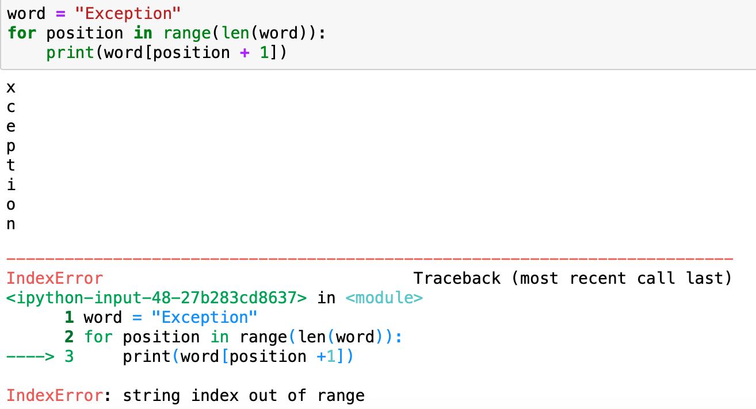
Common errors with string / lists

Slide 81
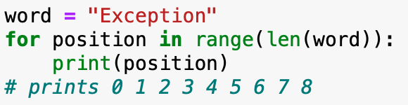
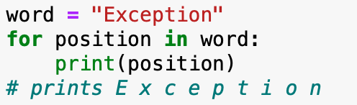
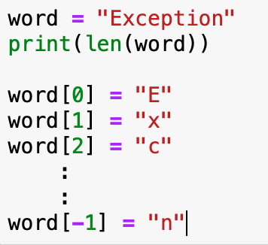
Common errors with strings / lists
vs
Lists begin at position 0 and continue to length-1
Each position can be accessed, but for strings they cannot be overwritten
TypeError: 'str' object does not support item assignment
Notes:
https://www.tutorialsteacher.com/python/error-types-in-python

Slide 82
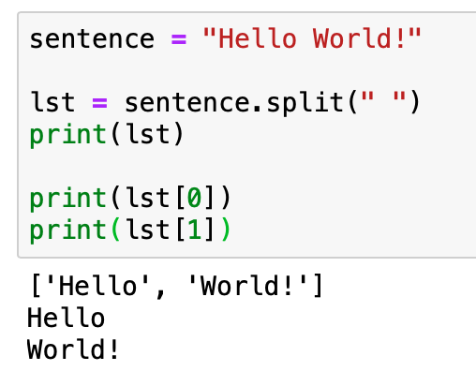
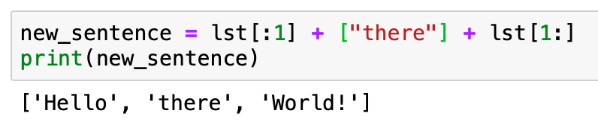
Slices of lists

Slide 83
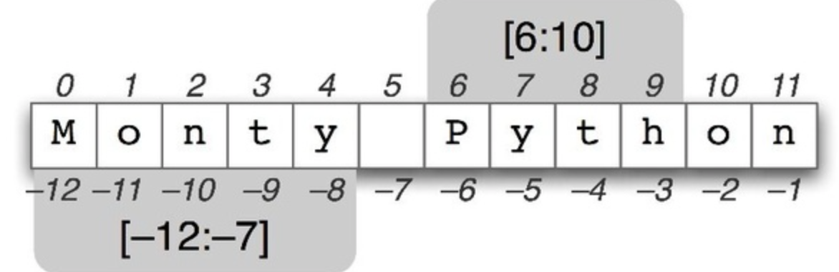

Reversing strings
Position ->
<- Negative Index

Slide 84

Functions
We use functions to re-use code in a program.
They are made defined with a name, parameters, and the code block below is indented.
Generally, they perform some operation on the arguments passed to them and return a result.
A function can be called anywhere in a program after being declared.
Notes:
https://www.tutorialspoint.com/python3/python_functions.htm <- these are good!

Slide 85
Functions
Sequence of statements which you can execute anywhere in your code after declaring.
Eliminates repetition in code. Functions can also reference other functions.
Make it easier to debug and find issues. Makes code easier to understand.
In short, functions allow us to split a large application into smaller chunks.
Notes:
https://www.tutorialspoint.com/python3/python_functions.htm <- these are good!

Slide 86
Functions
After a function is declared, we call it anywhere we want to use it in the program.
Functions generally will receive some input, known as arguments, perform some operation, and then return a result.
We can pass values to a function as arguments when we call it, such as in the last line of the code snippet below. This allows us to use functions in a general way, specifying the context with the arguments we pass in to it.
Notes:
https://www.tutorialspoint.com/python3/python_functions.htm <- these are good!

Slide 87
Functions
There are a lot of functions that can be used immediately because they are part of the base language of Python.
Examples: len() function, range() function.
Imagine having to code all of these from scratch without the Python Standard Library..
Challenge: create your own len() function that will work with a string or list.
Notes:
https://www.tutorialspoint.com/python3/python_functions.htm <- these are good!

Slide 88

Functions
Challenge: Make a calculator application with functions for each operation:
add, subtract, multiply, divide.
It doesn’t need to be complicated. Here is the first part:

Slide 89

Operators
Operators compare values, for example to see if two strings are equal or which of two numbers are smaller.
There are many operators that can be used in Python. We will encounter them as we go...
Notes:
https://www.w3schools.com/python/python_conditions.asp
Need to quiz on the operators
https://www.geeksforgeeks.org/basic-operators-python/
Conditionals. Booleans. Count the number of the’s in a paragraph
More on input and the types of split
https://www.geeksforgeeks.org/taking-multiple-inputs-from-user-in-python/

Slide 90

Operators
There are many operators that can be used in Python. We will encounter them as we go...
More can be read with a complete list here: https://www.w3schools.com/python/python_conditions.asp
Notes:
https://www.w3schools.com/python/python_conditions.asp
Need to quiz on the operators
https://www.geeksforgeeks.org/basic-operators-python/
Conditionals. Booleans. Count the number of the’s in a paragraph
More on input and the types of split
https://www.geeksforgeeks.org/taking-multiple-inputs-from-user-in-python/

